Slide 1

Watson Assistant Labs
Lab 5: Extending Your Chatbot with Watson Discovery

Slide 2


Objective
Extend your chatbot to handle long tail conversations
Watson Assistant
Watson Discovery
Watson
Assistant
Here Watson uses reasoning strategies that focus on the language and context of the question.
Help me pick a phone
My LG D800 is grinding to a halt, what can I do?
Frequency of Questions
Watson Discovery
Here Watson uses reasoning strategies that focus on identifying the most appropriate answer.
Short Tail
Long Tail
100s
100,000+

Slide 3
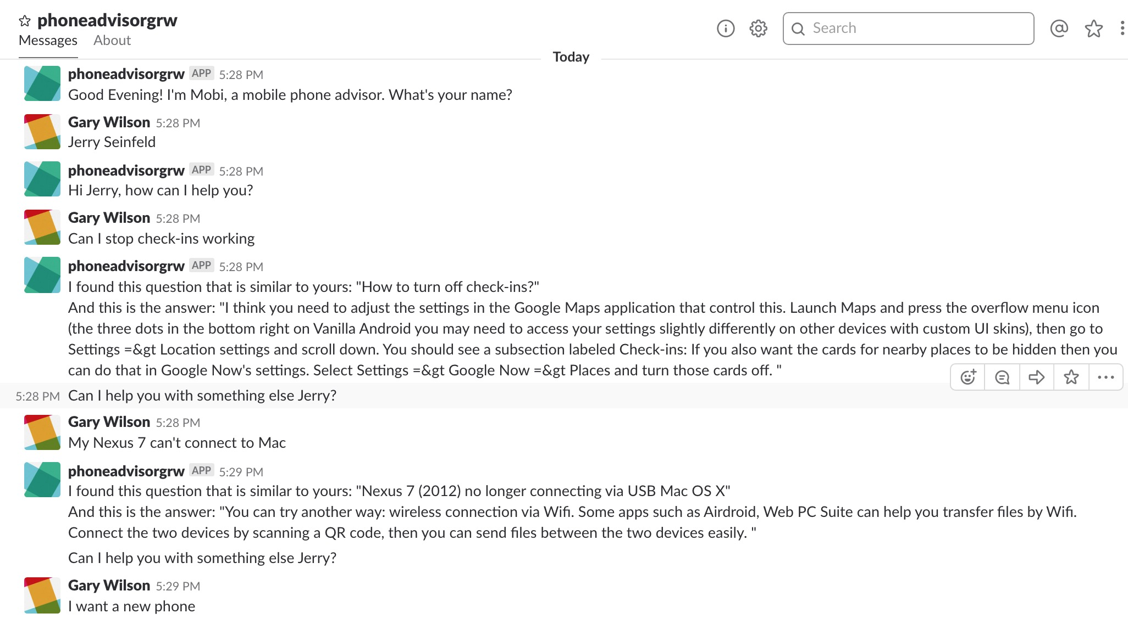
Objective

Slide 4

Agenda
Introduction to Watson Discovery
Setup the Discovery Service
Build a Discovery document collection
Query the collection using Watson Discovery Query Builder
Create a Watson Discovery IBM Cloud Function
Integrate Watson Discovery into Watson Assistant

Slide 5
What is the Discovery service?
a cognitive search and content analytics engine
helps rapidly build cognitive, cloud-based applications that unlock insights hidden in unstructured data
includes proprietary data, and public and third-party data
Basic terms
Collection Document Query

Slide 6
Collections and Documents
Collection = set of documents
Documents = JSON, DOC, HTML, PDF
contain data of potential use to an application
JSON question/answer pairs for use by chatbot
FAQ held in Word or PDF format, … etc.
Documents in your collection can be converted using a configuration file you specify
Watson Discovery can enrich (add cognitive metadata to) ingested documents with semantic information collected by 9 Watson functions
Entity Extraction, Sentiment Analysis, Category Classification, Concept Tagging, Keyword Extraction, Relation Extraction, Emotion Analysis, Element Classification and Semantic Role Extraction

Slide 7
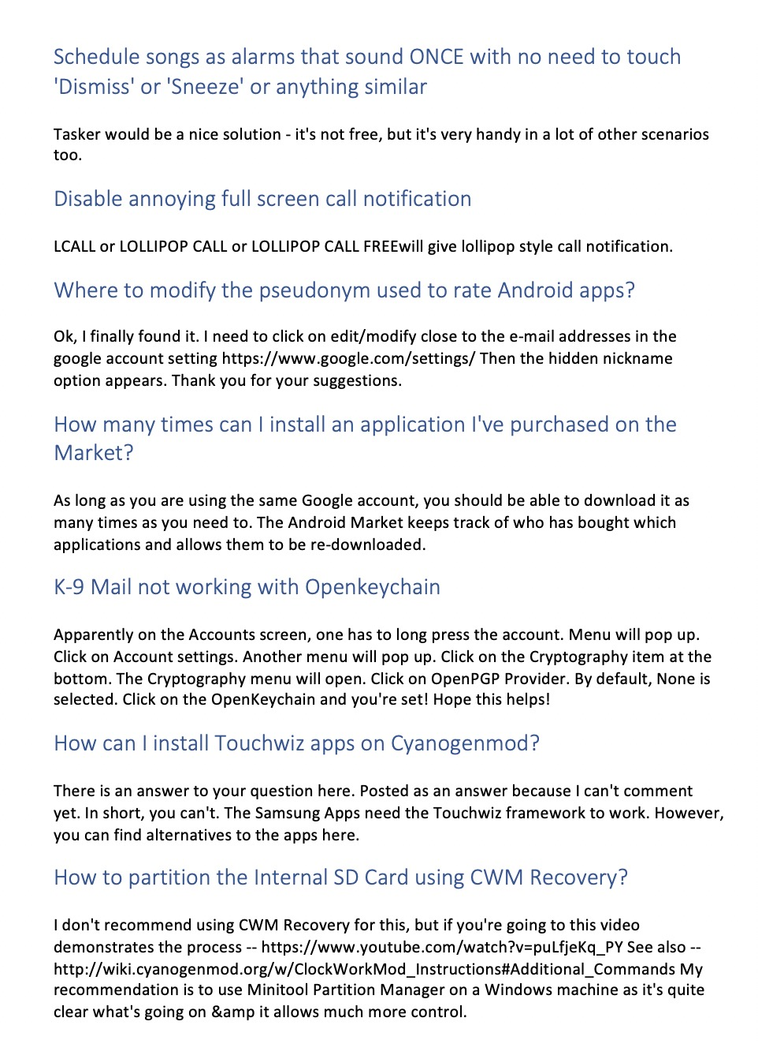
Lab: Word doc FAQs
10 Word documents, each with approximately 50 specific items of knowledge
ingest one sample document
use Smart Document Understanding (SDU) to visually tag content on a few pages of the sample document
Watson Discovery uses machine learning techniques to understand the rest of document
ingest all documents
Watson Discovery enriches content

Slide 8
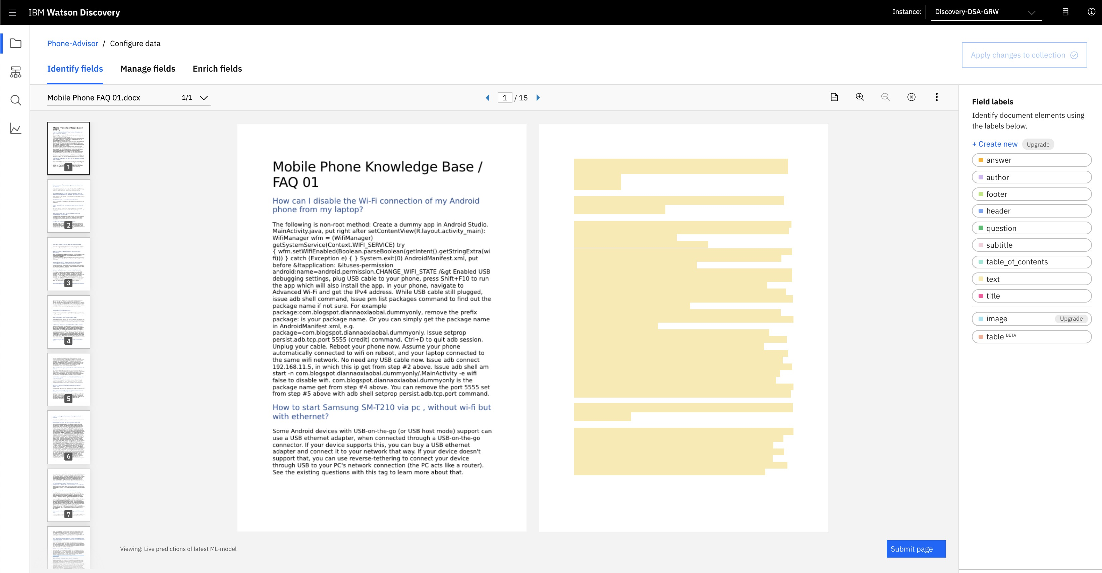

Slide 9
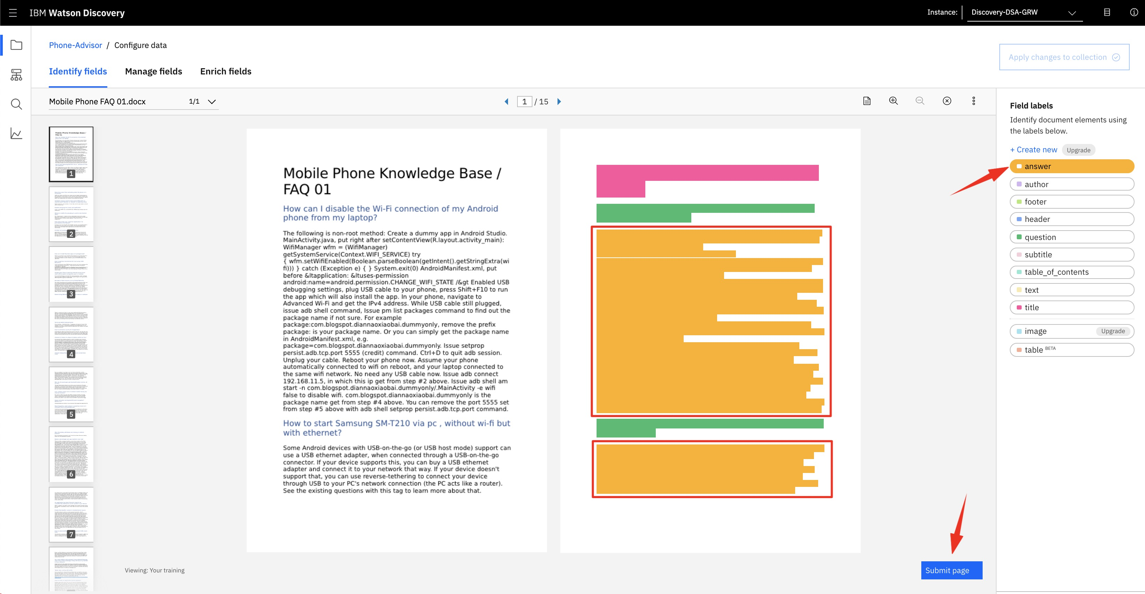

Slide 10
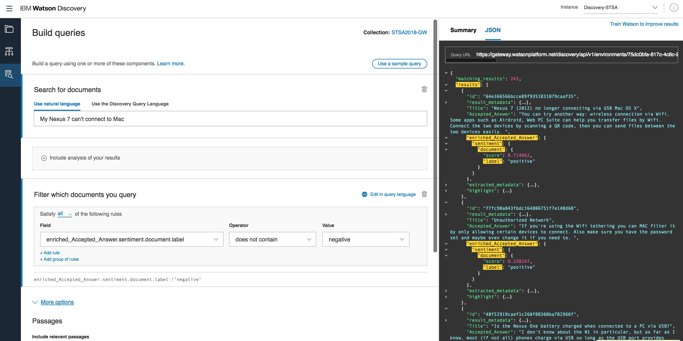
Queries
Watson Discovery offers powerful content search capabilities
once content is uploaded and enriched by the Discovery service, you can build queries, and
integrate Discovery into your own applications
create custom applications using the Watson Explorer Application Builder

Slide 11
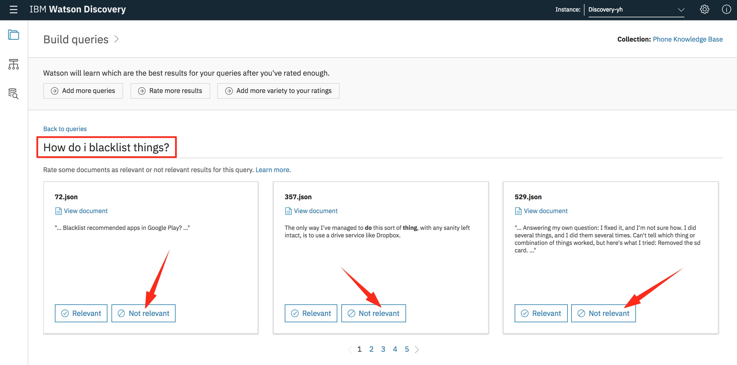
Relevancy Training
Watson Discovery has a powerful natural language capabilities, but the relevance of query results can be even further improved with training
this relevancy training is optional – if the results of your queries meet your needs, no further training is necessary
you can train your collections using either the Discovery tooling or APIs
in order to train Watson you provide example queries, and rate the results for each query as relevant/not relevant
Watson doesn't just memorise – it learns from these queries and applies patterns it has detected to all new queries, using machine-learning techniques that find signals in your content and questions

Slide 12
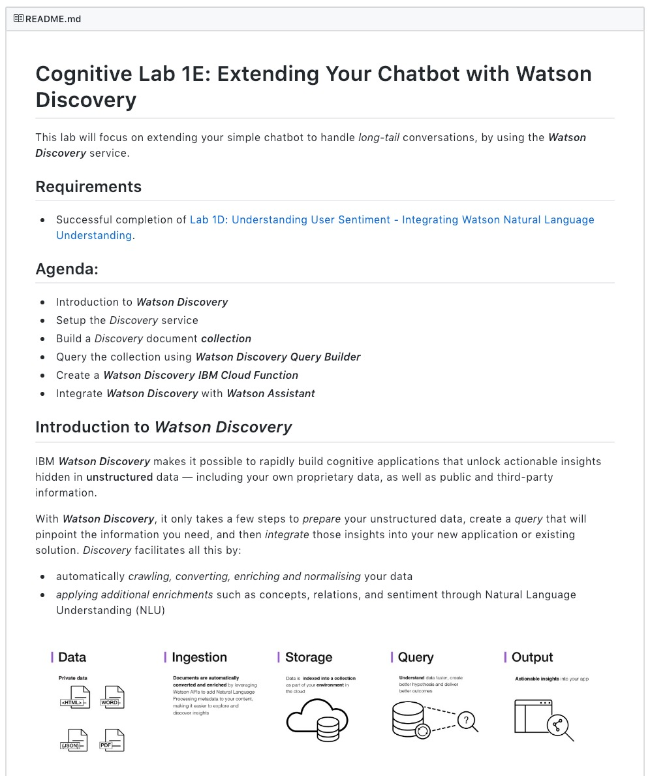
Lab Format
Step-by-step instructions
GitHub README.md for each lab
Work at your own pace
https://github.com/garyrwilson/Watson-Assistant-Labs/5-Discovery

Slide 13
Watson Assistant Labs
Lab 5: Extending Your Chatbot with Watson Discovery

